Slide 1

Stock market prediction using sentimental analysis
By : Pratham Pathak
Anshul Aditya

Slide 2

Importance
1. Provides insights into market sentiment for informed decision-making.
2. Helps in managing risks by identifying potential market shifts.
3. Contributes to market efficiency by better pricing assets.
4. Facilitates algorithmic trading strategies based on real-time sentiment data.
5. Analyzes the impact of events or news on stock prices.
6. Aids in forecasting market trends and anticipating movements.
7. Offers a competitive advantage by understanding sentiment and trends.

Slide 3
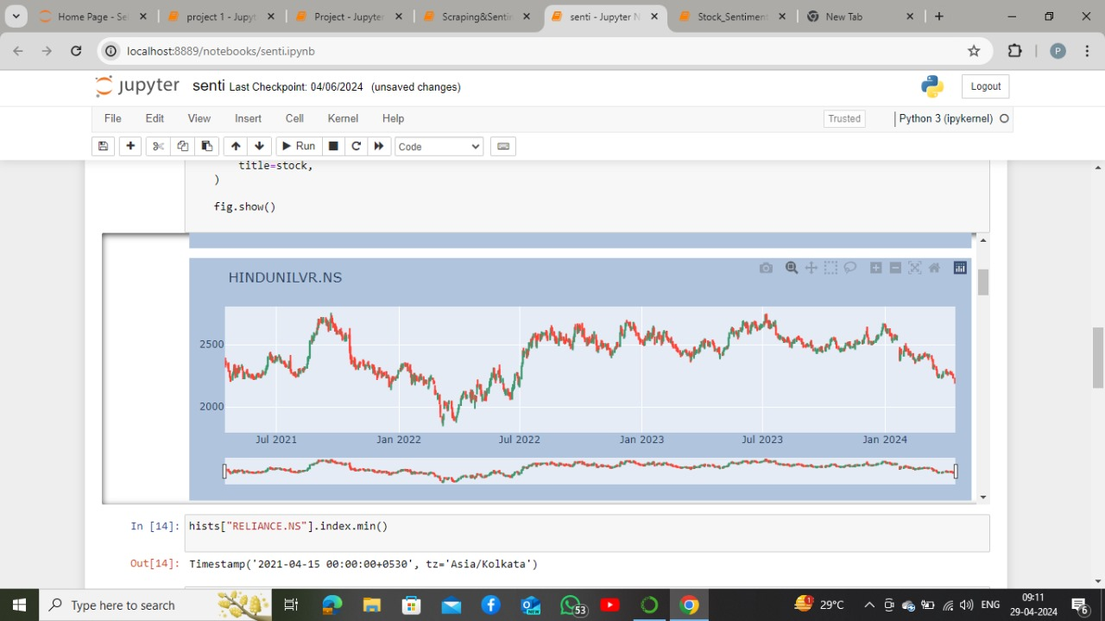

Slide 4
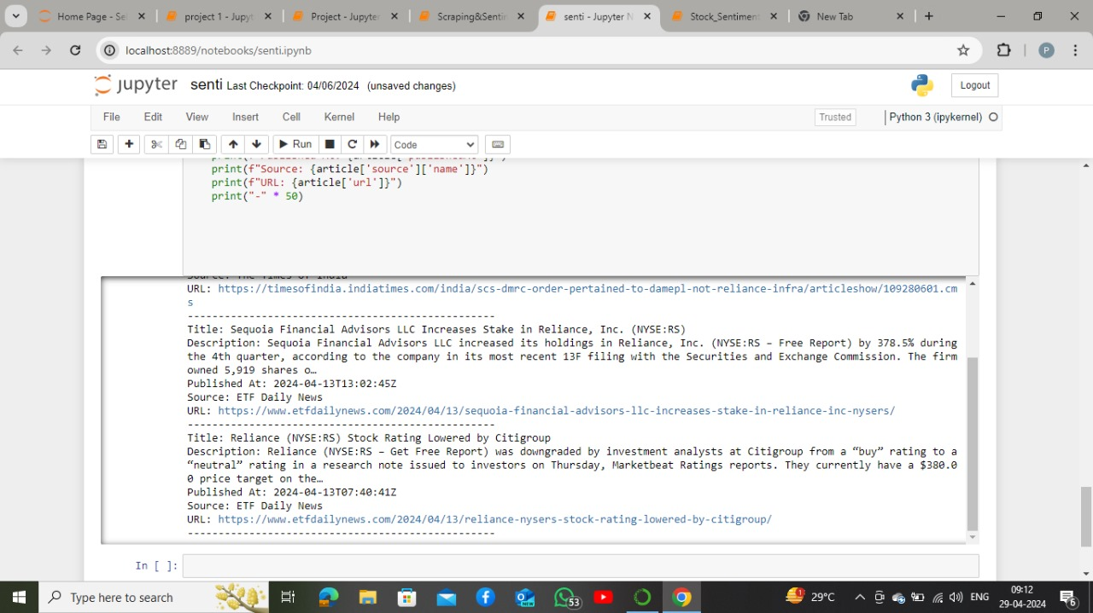

Slide 5
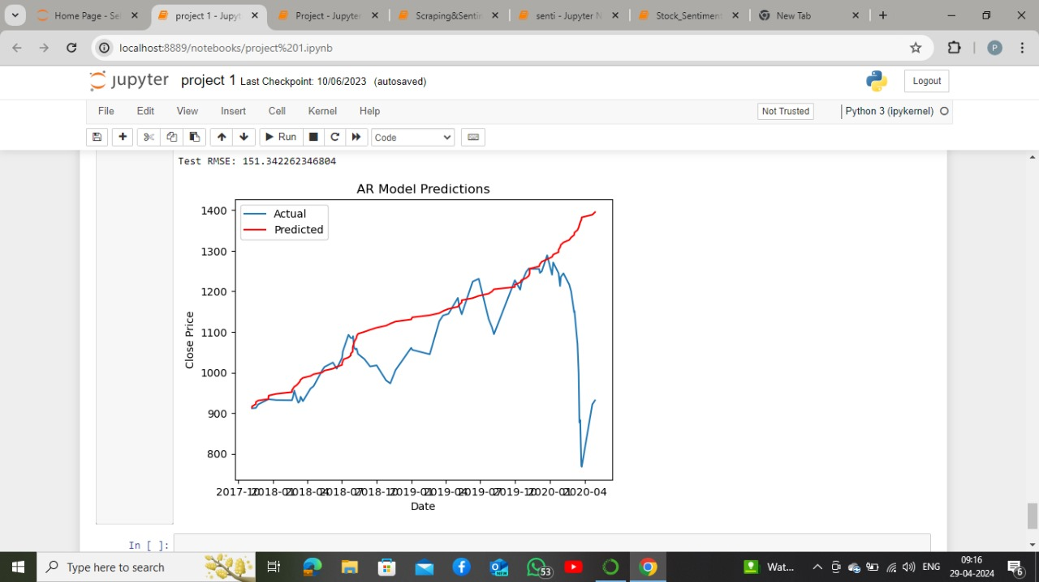

Slide 6
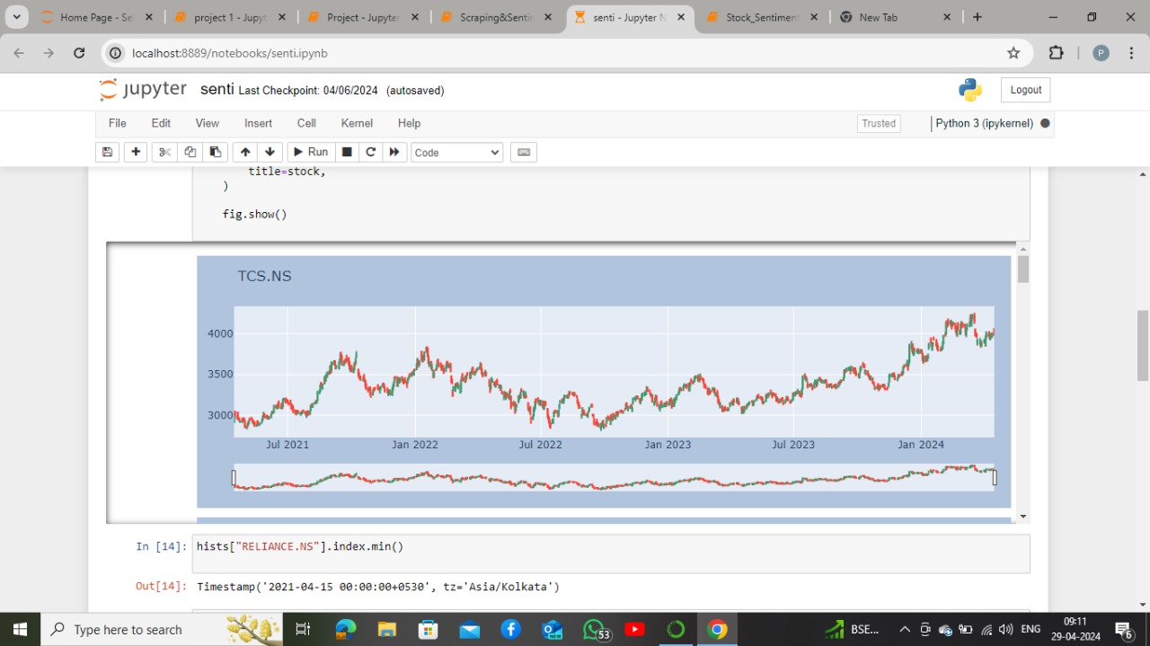

Slide 7
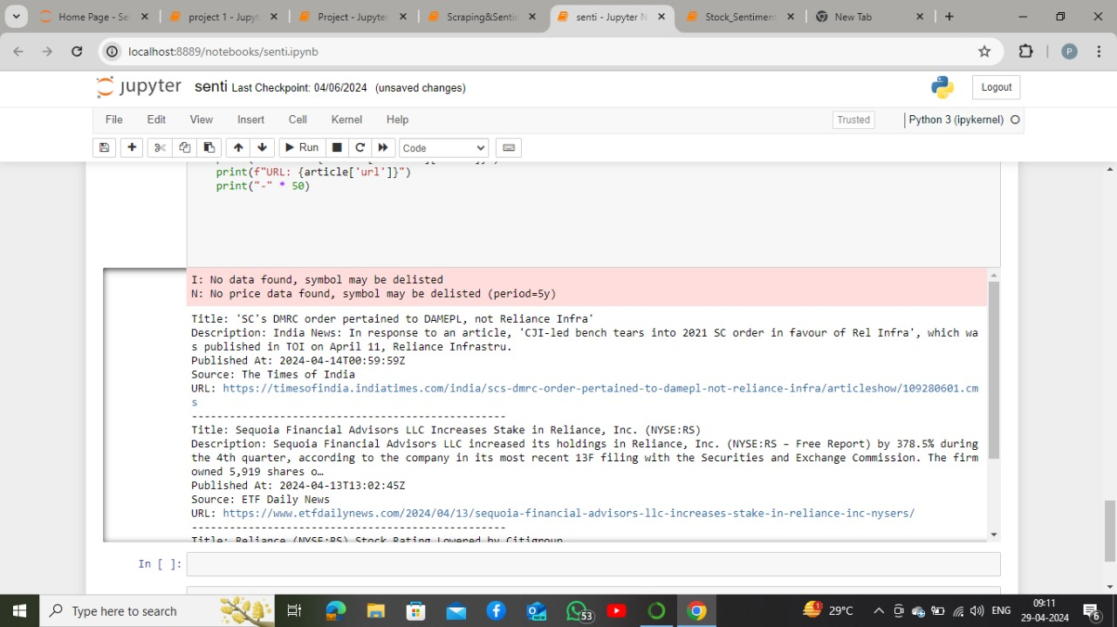

Slide 8
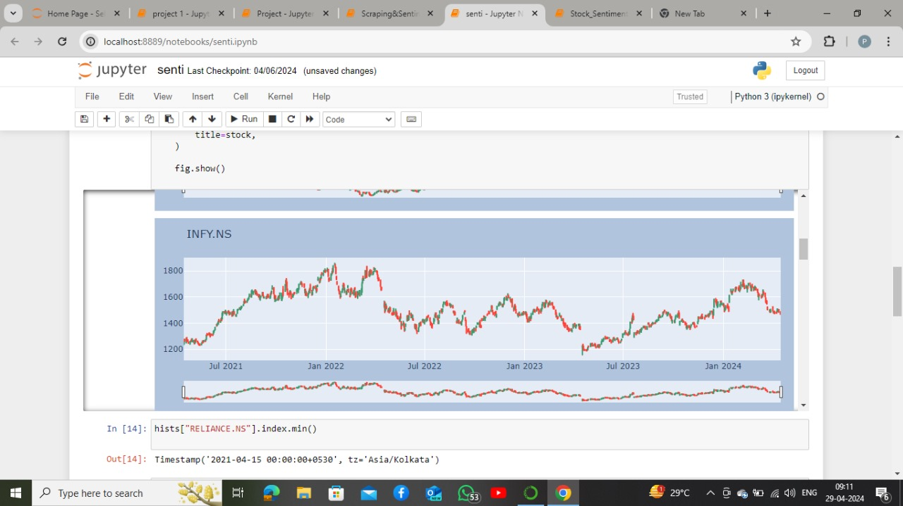

Slide 9
Role of our project
1. Data Collection: Gathering and analyzing data from various sources like social media, news, and financial reports to assess market sentiment.
01
2. Market Sentiment Evaluation: Determining whether market sentiment is positive, negative, or neutral towards specific stocks, sectors, or the market overall.
02
3. Pattern Recognition: Identifying patterns and trends in sentiment data to predict potential market movements and trends.
03
4. Event Impact Analysis: Assessing the impact of events, news, or announcements on stock prices and market sentiment.
04
5. Algorithmic Trading: Integrating sentiment analysis into algorithmic trading systems to automate trading decisions based on sentiment-driven insights.
05

Slide 10
Types of data used
1. Social Media Data: Platforms like Twitter, Facebook, and Reddit provide a wealth of data in the form of user posts, comments, and discussions related to stocks, companies, and the overall market sentiment.
2. News and Media Reports: Financial news outlets, blogs, and websites publish news articles, reports, and analysis that can impact market sentiment. Sentiment analysis extracts sentiment from these textual sources.
3. Financial Reports and Filings: Quarterly and annual financial reports, earnings calls, and regulatory filings (e.g., SEC filings) contain valuable financial and operational data that can influence investor sentiment.
4. Surveys and Opinion Polls: Investor sentiment surveys, opinion polls, and market sentiment indices provide direct feedback on investor sentiment, helping gauge market mood and sentiment trends.

Slide 11
Algorithms used
1. Naive Bayes: This algorithm is based on Bayes' theorem and is often used for text classification tasks like sentiment analysis. It calculates the probability of a sentiment label given the input features.
2. Support Vector Machines (SVM): SVM is a supervised learning algorithm that separates data points into different classes using a hyperplane. It can be effective for sentiment analysis by finding the best boundary between positive and negative sentiment data points.
3. Logistic Regression: Logistic regression is another common algorithm for binary classification tasks like sentiment analysis. It models the probability of a sentiment label based on input features.

Slide 12
Challenges
1. Noisy Data: Sentiment data from sources like social media and news can be noisy, containing irrelevant or misleading information that can impact the accuracy of sentiment analysis models.
2. Context Understanding: Understanding the context of sentiment expressions is crucial but challenging. For example, sarcasm, irony, and figurative language can lead to misinterpretations if not properly handled.
3. Data Bias: Sentiment analysis models can be biased due to imbalanced datasets or biased training data, leading to skewed predictions and unreliable results.
4. Market Dynamics: Financial markets are influenced by numerous factors, including economic indicators, geopolitical events, and market sentiment itself. Capturing the interplay of these factors accurately in sentiment analysis can be complex.
5. Lack of Ground Truth: Determining ground truth labels for sentiment analysis in financial markets is challenging, as sentiments can be subjective and vary among individuals.

Slide 13

Conclusion
In conclusion, sentiment analysis for stock market prediction faces challenges such as noisy data, context understanding, market dynamics, and model overfitting. Overcoming these challenges requires advanced machine learning techniques, domain expertise, and continuous model refinement to build accurate and reliable sentiment analysis models for effective market prediction.

